Slide 1


TẬP ĐOÀN BƯU CHÍNH VIỄN THÔNG VIỆT NAM
Introduction to React and Redux
Lê Văn Tùy | VNPT IT - PM1 | Email: tuylv@vnpt.vn | Mobile: 0919249247
Notes:
1
1

Slide 2
Content
Single-page application
React
Redux
React Redux
1. PROPOSED WORKING PRINCIPLE

Slide 3
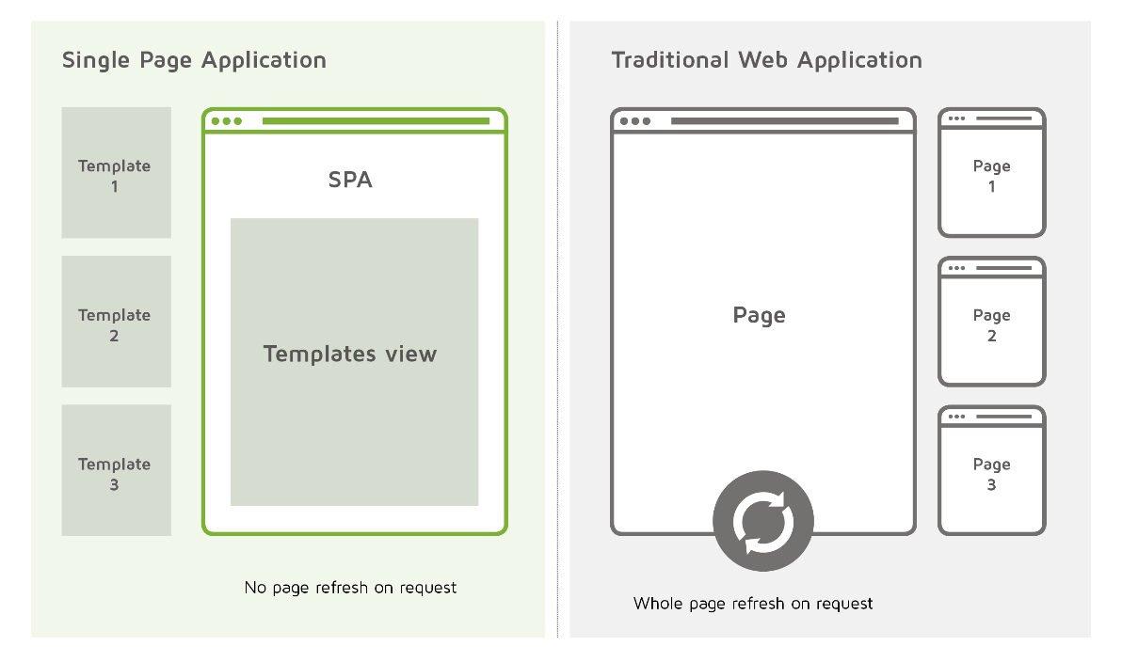
Single-page application (SPA)
A single-page application is an app that works inside a browser and does not require page reloading during use.
E.g. Gmail, Google Maps, Facebook or GitHub.

Slide 4
State-based approach
We manage state and view separately.

Slide 5

React
A JavaScript library for building user interface, built by an engineer at Facebook and released to the developer community under an open-source license in 2013.
Virtual DOM
Component-Based
One-way data flow
Learn Once, Write Anywhere

Slide 6
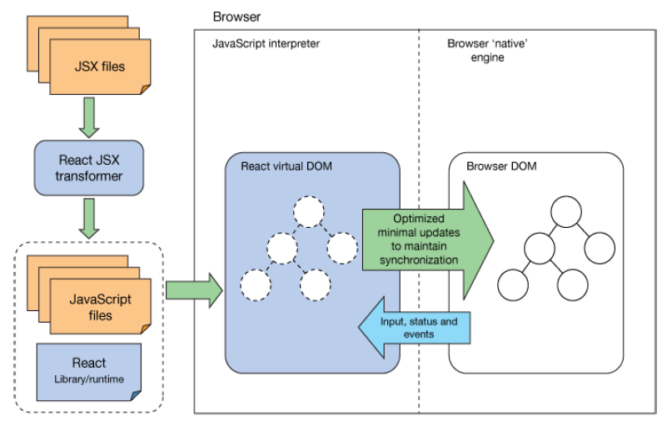
How it works
“You declaratively specify your
web UI components hierarchy
and feed it to React's virtual
DOM. Then React takes care of
the synchronization of your UI
with the browser's actual DOM
at the appropriate time.”
Notes:
(1): Bác sỹ kê đơn sử dụng phần mềm HIS
(2): Kiểm tra đơn thuốc có thuốc kháng sinh hay thuốc bắt buộc bán theo đơn
(3): Phần mềm HIS sinh mã đơn, mã xác thực theo thuật toán quy định
(4): HIS gửi đơn thuốc kháng sinh lên cổng để kiểm soát
(5): Cấp đơn có in mã xác thực cho bệnh nhân để mua thuốc
(6b): Gửi đơn sang hiệu thuốc của bệnh viện để bán/cấp thuốc
(7b): Bệnh nhân mua thuốc từ hiệu thuốc bệnh viện
(6): Bệnh nhân mang đơn đến hiệu thuốc tư nhân để mua thuốc
(7): Hiệu thuốc tra đơn thuốc trên cổng theo mã xác thực và họ tên bệnh nhân và bán thuốc cho bệnh nhân
(8): Hiệu thuốc gửi xác nhận số lượng thuốc đã bán trong đơn lên cổng để kiểm soát

Slide 7
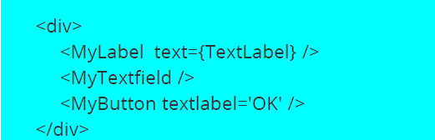
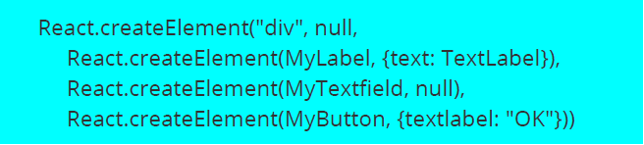
JSX
A syntax extension to JavaScript to produce React elements.
Is translated into JavaScript React API calls like this.

Slide 8
Components
Components let you split the UI into
independent, reusable pieces, and think
about each piece in isolation.
Single responsibility principle: A component should ideally only do one thing.

Slide 9
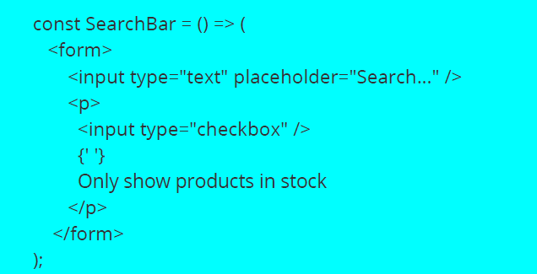
Stateless Functional Components
Useful for dumb/presentational components.

Slide 10
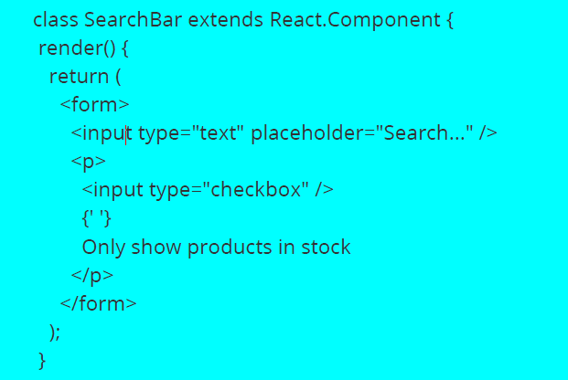
Class Components
Convert a functional component to a class if you need lifecycle methods, refs, or want to optimize performance using shouldComponentUpdate.

Slide 11
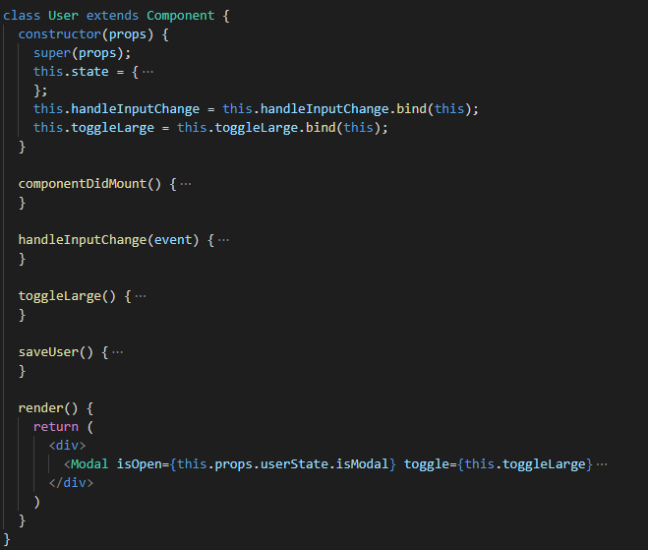
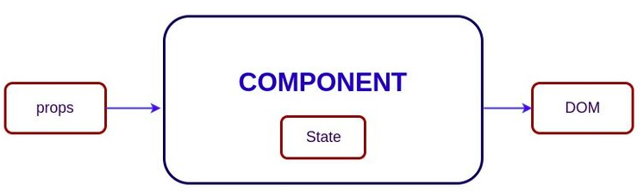
Props and State
Props and state holds information about the component.
Props are received from a parent component and are read only.
State is used for internal communication inside component.

Slide 12
Flow of Data and Events
A parent-component should set the props of a child-component to pass any data from the parent to the child.
User-events (mouse, keyboard, touches) will always bubble up from the child all the way to the
root component, unless handled in between.

Slide 13
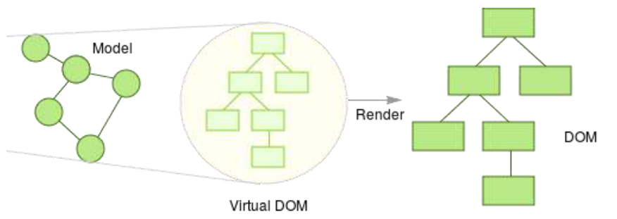
Virtual DOM
A light-weight, pure JavaScript data structure of plain objects and arrays that represents a real DOM object graph.

Slide 14
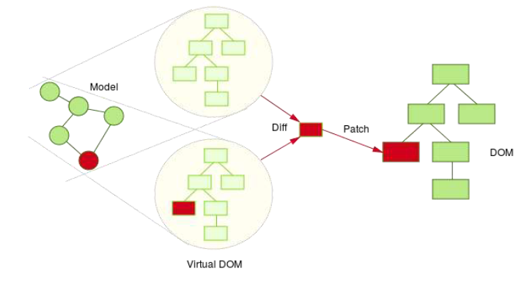
Virtual DOM
When something changes, render() runs to create new virtual DOM. React diffs with the old one and updates what needed.

Slide 15
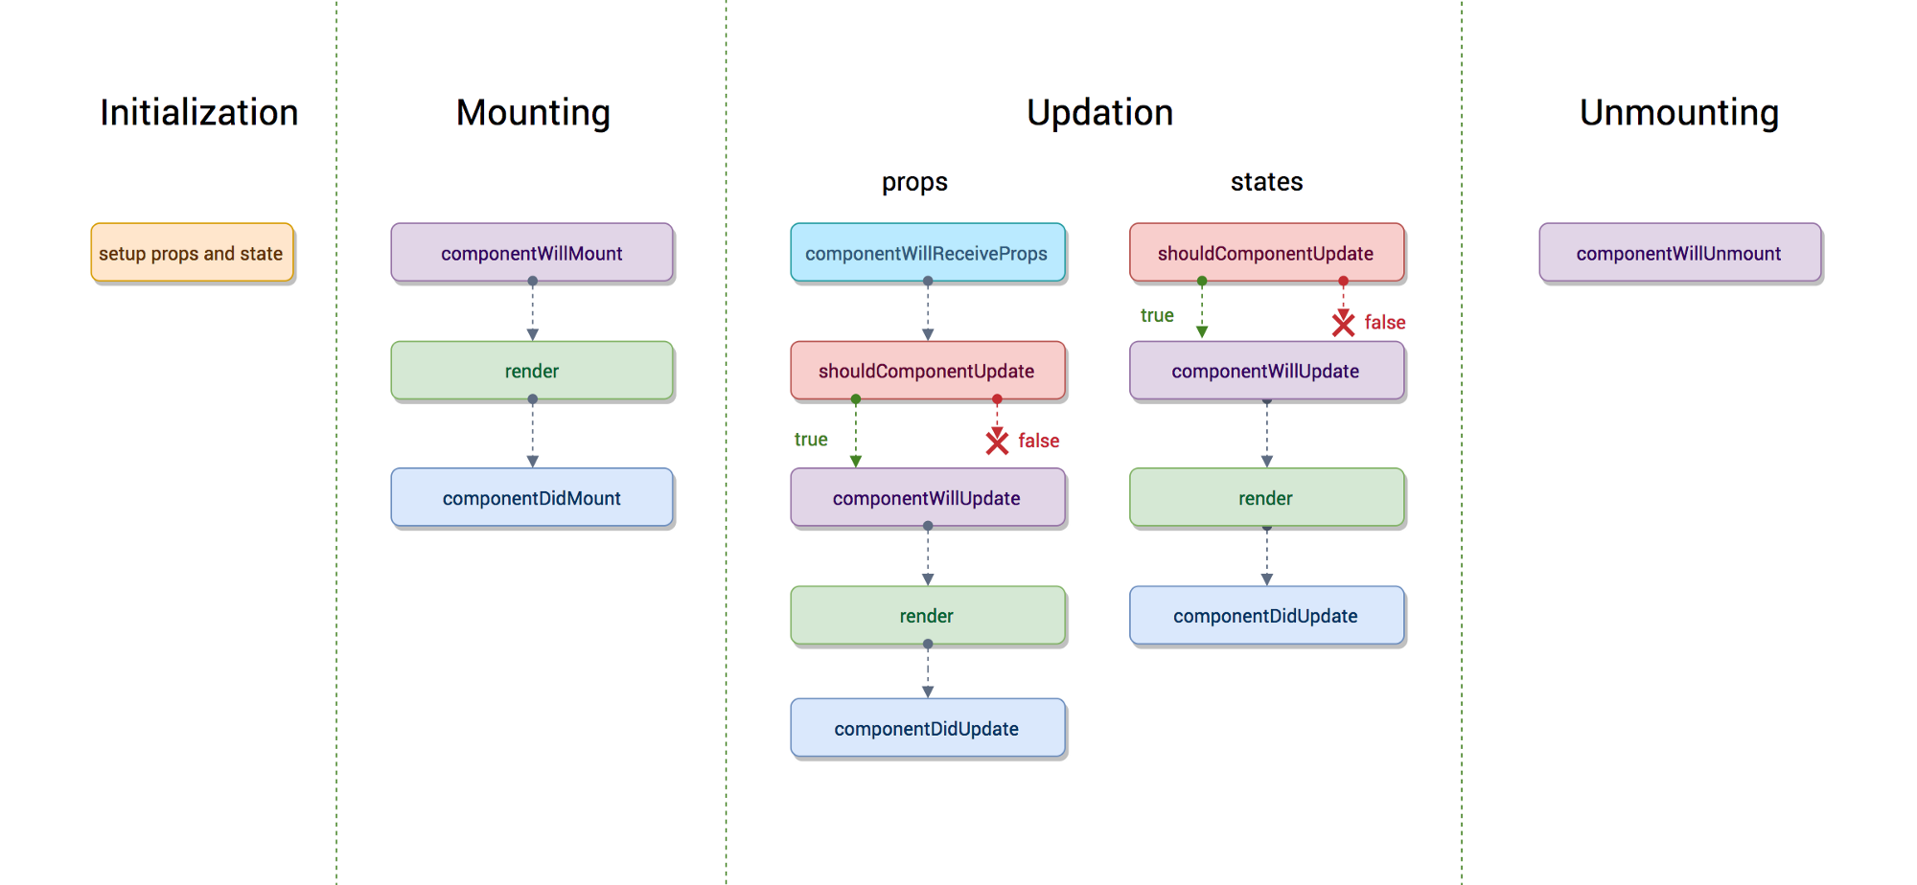
Life Cycle Events
The process where all stages that React component goes through are involved is called the component’s lifecycle.
React provides several methods
that notify us when certain stage
of this process occurs. These methods are called the component’s lifecycle methods.

Slide 16
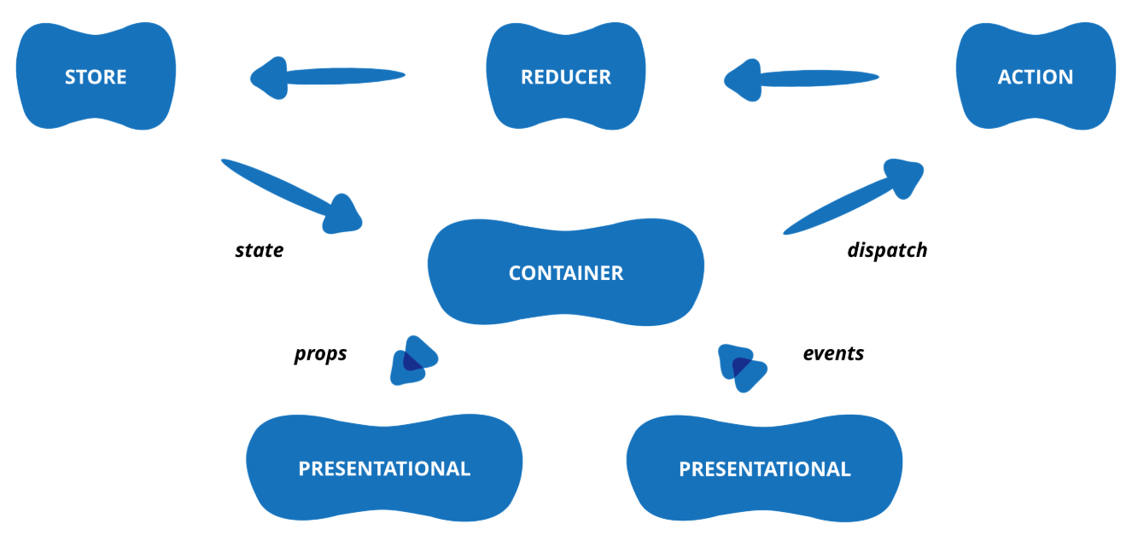
Redux
A tool for managing both data-state and UI-state in JavaScript applications.

Slide 17
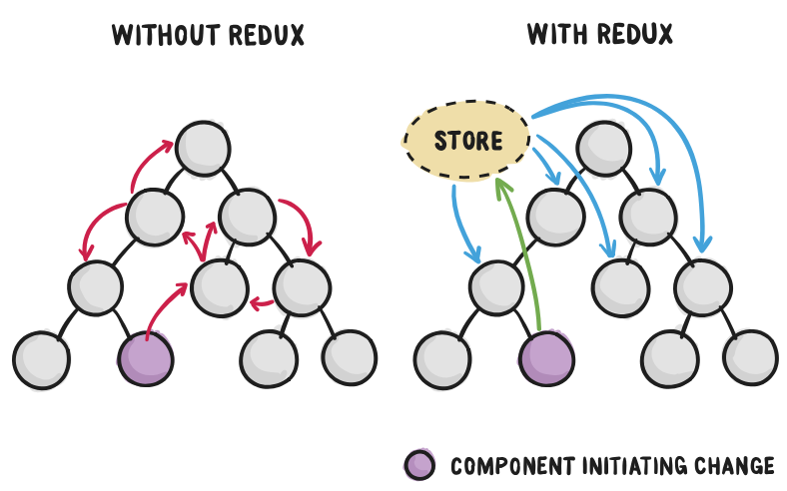
Why Redux?
Our code must manage more state than ever before.
New requirements becoming common in front-end product development.
Redux attempts to make state mutations predictable by imposing certain restrictions on how and when updates can happen.

Slide 18
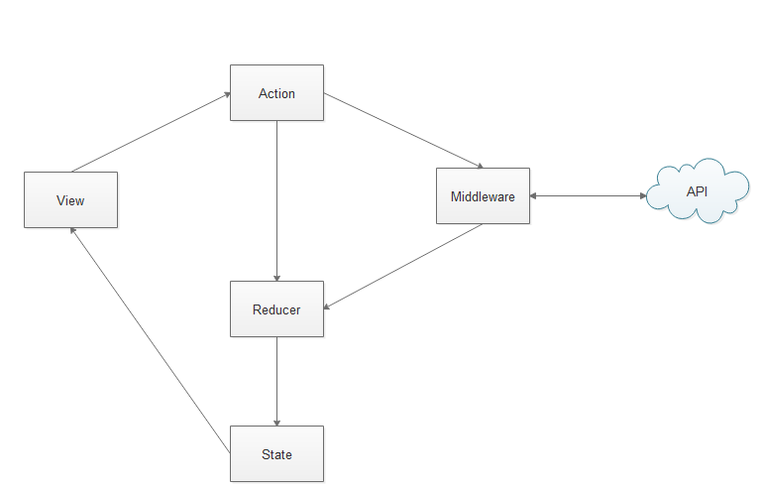
Three Principles
Single source of truth.
State is read-only.
Changes are made with pure functions.

Slide 19
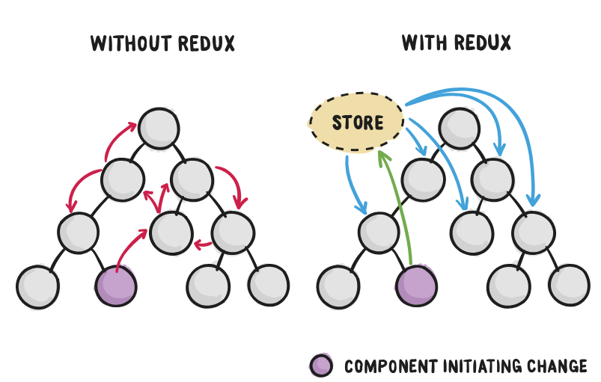
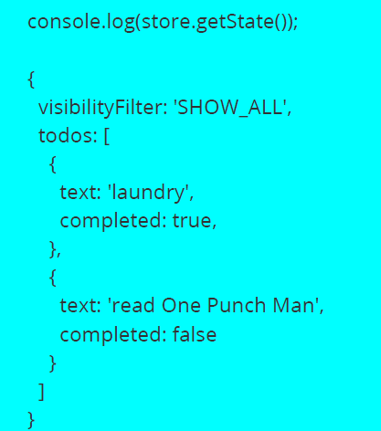
Single source truth
The state of your whole application is stored in an object tree within a single store, typically a deeply nested object for a real application.

Slide 20
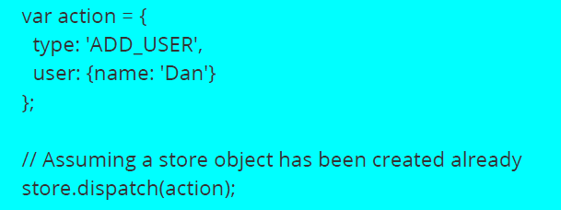
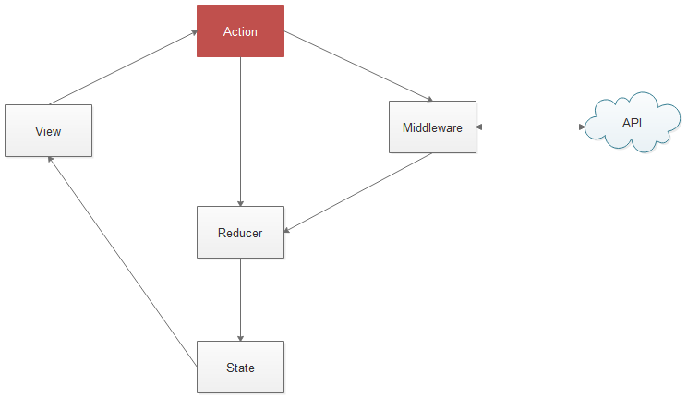
State is read-only
The only way to change the state is to emit an action, an object describing what happened.

Slide 21
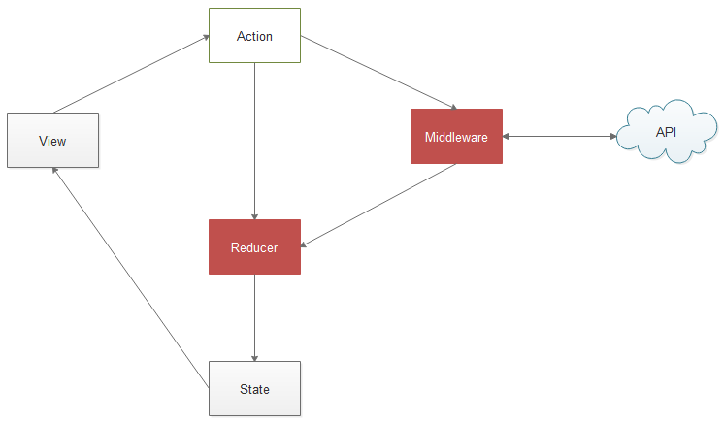
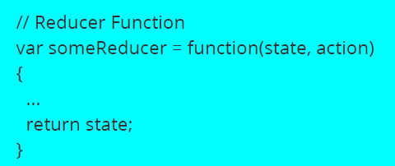
Changes are made with Pure Functions
To specify how the state tree is transformed by actions, you write pure reducers.
A reducer takes in current state as an argument and can only modify the
state by returning new state.

Slide 22
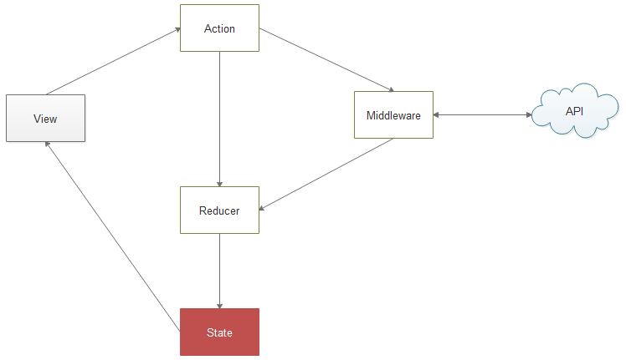

Access state from Store
To get state from store

Slide 23
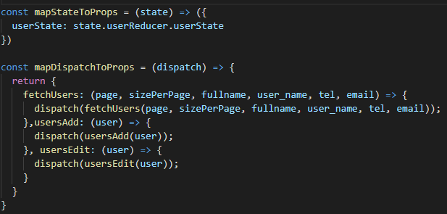
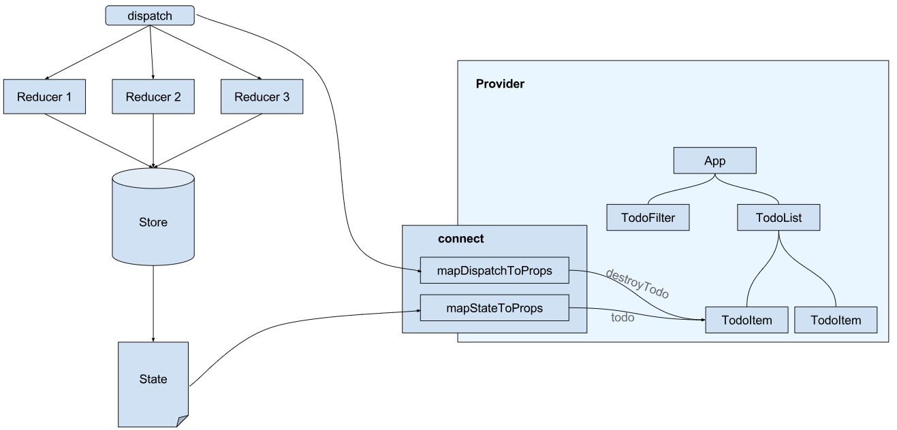
React Redux
Integrate Redux’s state management into a React application.

Slide 24
References
React: https://reactjs.org
Redux: http://redux.js.org
Change And Its Detection In JavaScript Frameworks: http://teropa.info/blog/2015/03/02/change-and-its-detection-in-javascript-frameworks.html
React: Create maintainable, high-performance UI components: https://www.ibm.com/developerworks/library/wa-react-intro/index.html
Leveling Up with React-Redux: https://css-tricks.com/learning-react-redux
Understanding the React Component Lifecycle: http://busypeoples.github.io/post/react-component-lifecycle

Slide 25
TẬP ĐOÀN BƯU CHÍNH VIỄN THÔNG VIỆT NAM
XIN CHÂN THÀNH CẢM ƠN!

